Slide 1
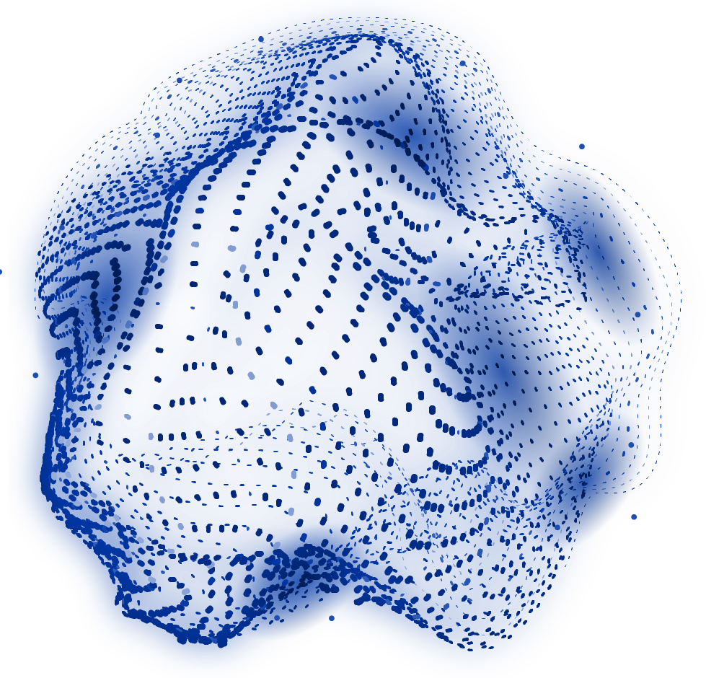


Validating QA-Pairs
The answer to the question is to
question the answer

Slide 2

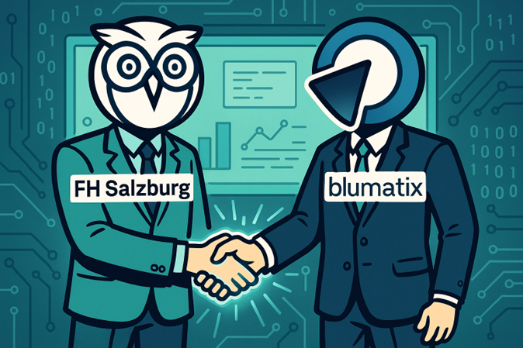

Cooperation Partners
FH Salzburg
Jonas Kubesch
Blumatix
Blumatix staff Martin, Philipp, Rudi, Klemens

Slide 3
TABLE OF CONTENTS
01
02
03
ABOUT THE PROJECT
Short introduction
IMPLEMENTATION
Building a validation pipeline
RESULTS
Findings of validation

Slide 4
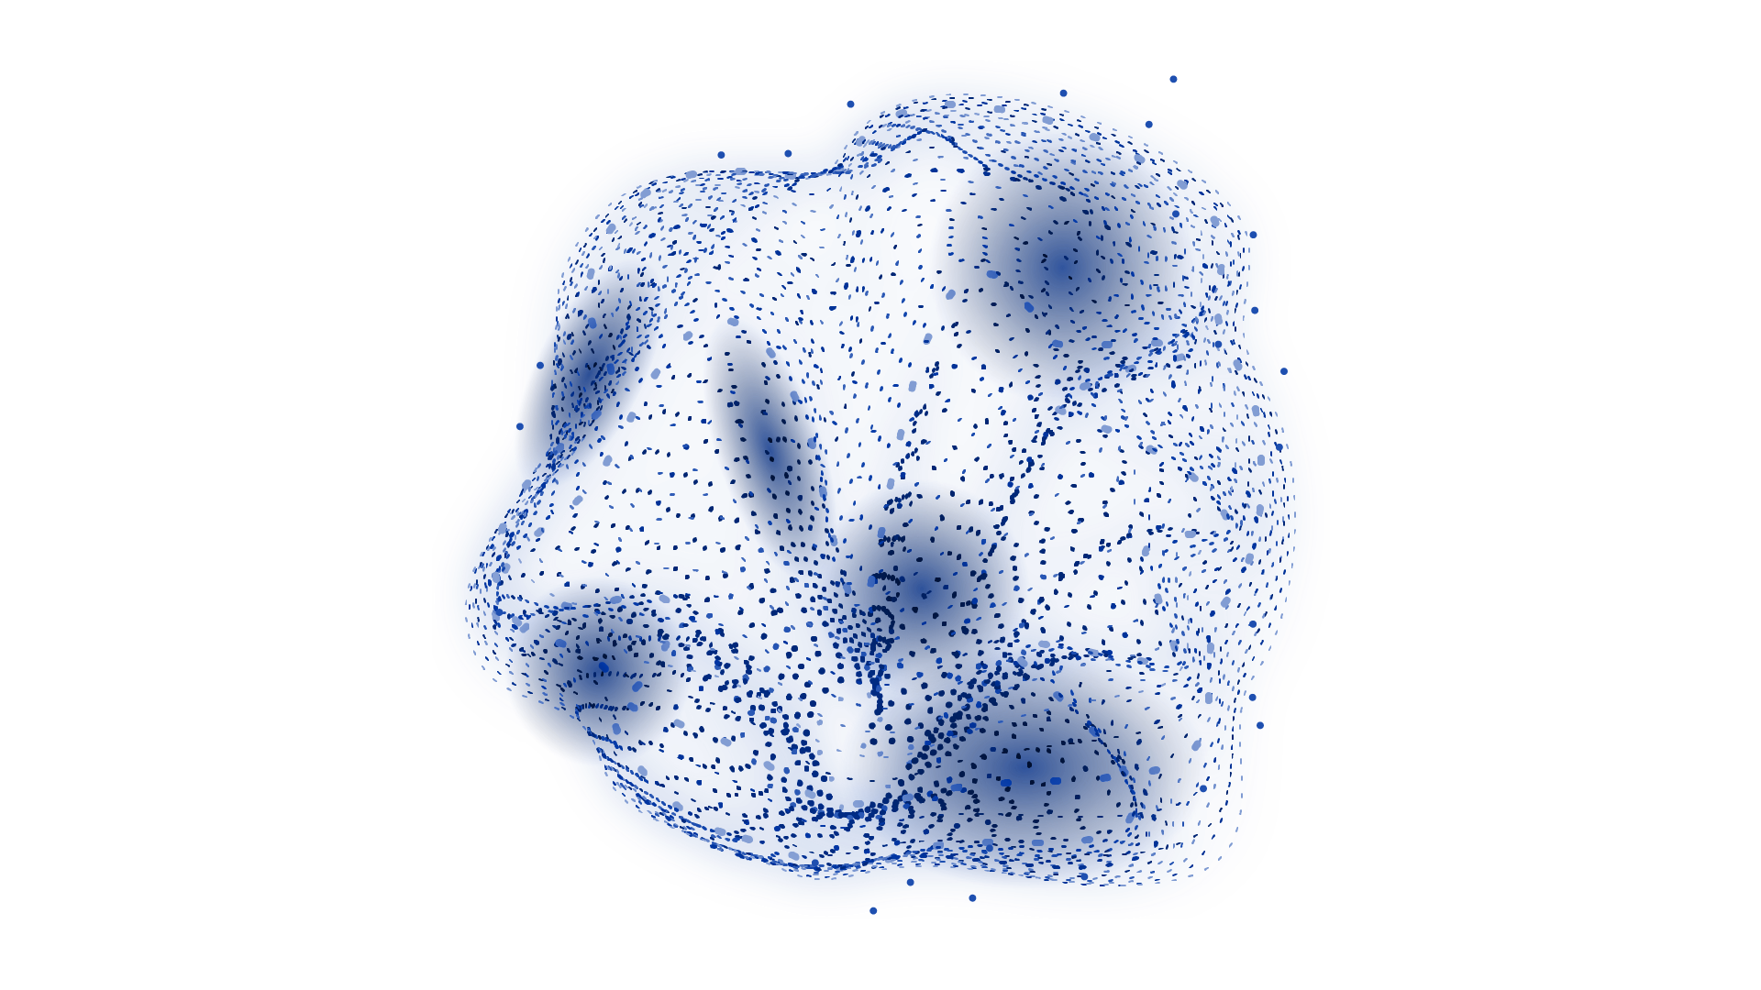
01
ABOUT THE PROJECT
Answering all your questions

Slide 5
PROJECT GOALS
Future
Have a Blumatix-aware Chatbot assistant
Inter-mediate
Automate knowledge extraction from arbitrary documents
Short
Evaluate LLM-generated QA Pairs

Slide 6
02
Implementation
Tech dude shows tech stuff…

Slide 7
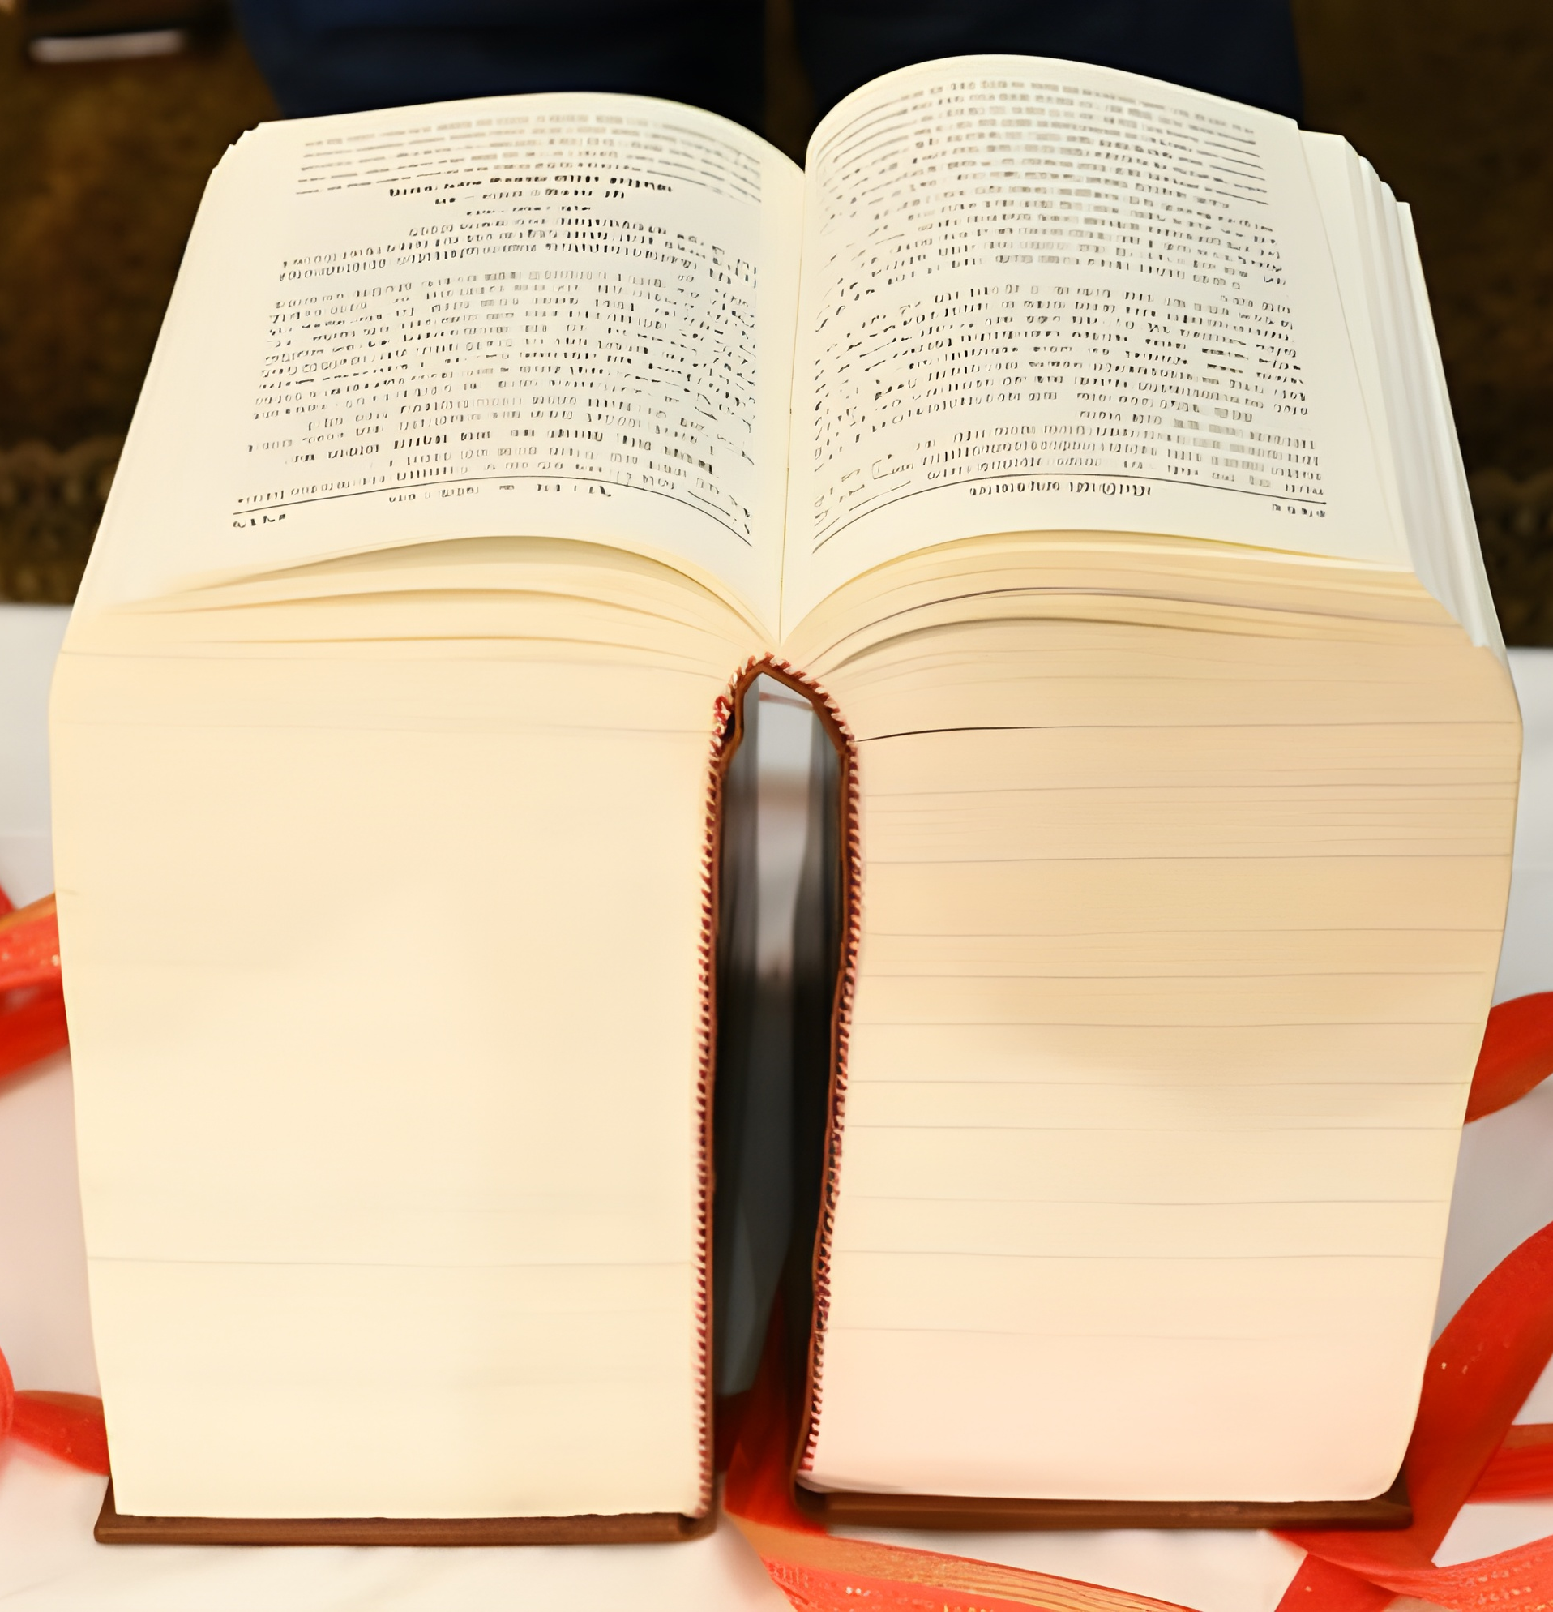
Long documents – Many problems
Nobody reads such long documents
How to verify whether the LLM creates correct QA pairs?

Slide 8
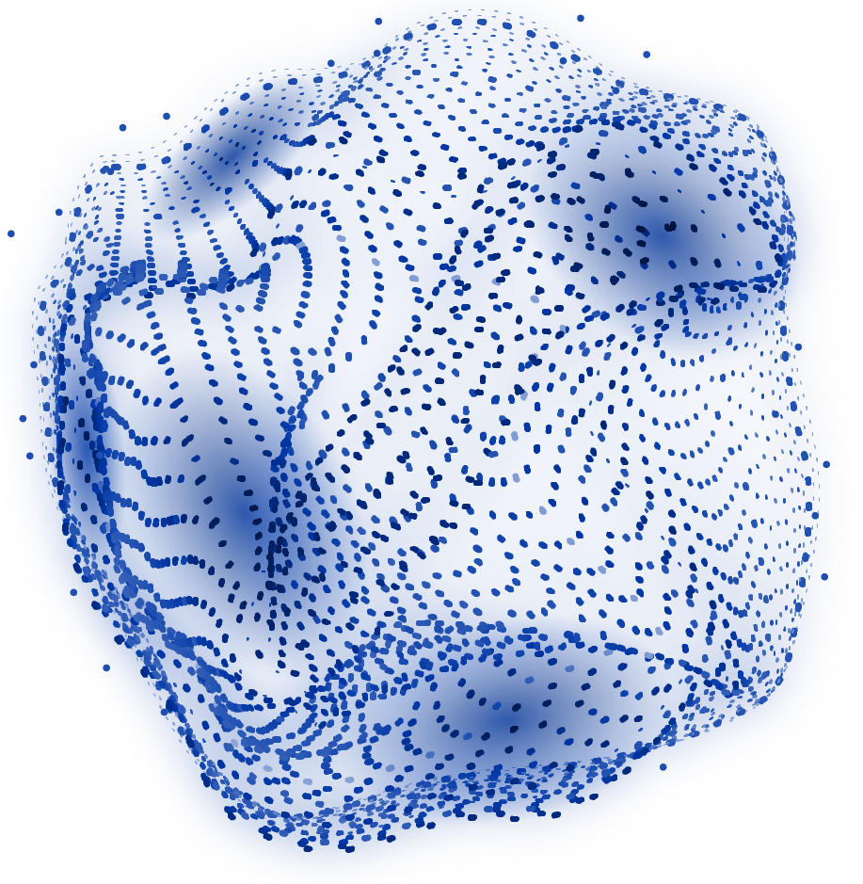
RAG IS BACK

Slide 9
PIPELINE
Chunk reference document
Compare answer with retrieved information
STEP 2
STEP 4
STEP 1
STEP 3
Retrieve Reference, Question and Answer
Iteratively retrieve document chunks

Slide 10
03
RESULTS
Not generated by AI – I swear!

Slide 11
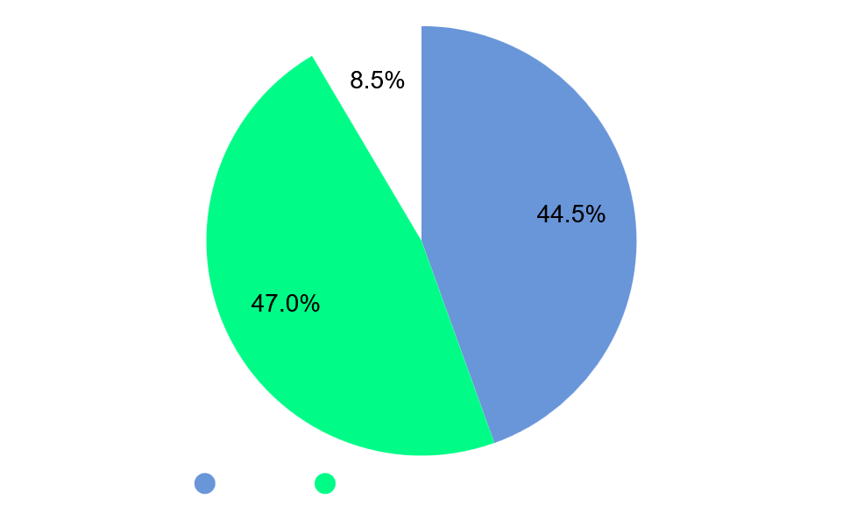
200 QUESTIONS FOR GPT-4
44.5%
TRUE
Correct
47.0%
FALSE
Wrong or unsupported
8.5%
INCOMPLETE
Answer lacks information

Slide 12
QA
Question
Answer
Welche Branchen und Unternehmenstypen profitieren laut Whitepaper besonders von BLU DELTA?
Laut Whitepaper profitieren besonders Branchen und Unternehmenstypen von BLU DELTA, die regelmäßig große Mengen an Geschäftsdokumenten verarbeiten und hohe Anforderungen an Effizienz, Genauigkeit und Datenschutz stellen. Dazu zählen global agierende Industrieunternehmen, die komplexe Lieferketten und umfangreiche Rechnungsprozesse automatisieren wollen, sowie Bauunternehmen, bei denen eine präzise und schnelle Verarbeitung von Bau- und Projektdokumenten entscheidend ist. Versicherungsunternehmen nutzen BLU DELTA, um Schadenmeldungen, Policen und Abrechnungen automatisiert zu verarbeiten und so Bearbeitungszeiten zu verkürzen. Steuerberatergruppen profitieren von der automatisierten Belegerkennung in der Finanzbuchhaltung, wodurch sie ihre Mandanten schneller und präziser betreuen können. Auch B2B-Service-Provider setzen BLU DELTA ein, um für ihre Kunden Dokumentenprozesse effizient zu digitalisieren. Darüber hinaus eignet sich die Lösung für ERP- und DMS-Anbieter, die die BLU DELTA KI in ihre Software integrieren, um ihren Kunden eine moderne, KI-gestützte Dokumentenverarbeitung anzubieten. In der DACH-Region wird BLU DELTA bereits in mehr als 1.000 großen und mittelständischen Unternehmen eingesetzt. Durch den Shared-Intelligence-Ansatz profitieren alle Branchen gleichermaßen von kontinuierlichen Verbesserungen in der Erkennungsleistung, die aus Millionen verarbeiteter Dokumente, regelmäßigen Benchmarks und umfassenden Qualitätssicherungsprüfungen resultieren. Diese breite Einsetzbarkeit macht BLU DELTA zu einer universellen Lösung für alle Unternehmen, die ihre Dokumentenprozesse digitalisieren, automatisieren und optimieren wollen.",

Slide 13
OUTPUT
Supporting
Contradicting
Page 5: "Integriert in Business-Software entlastet die BLU DELTA KI im DACH Raum die Mitarbeiter von mehr als 1000 großen und mittelständischen Unternehmen.
Answer states: "global agierende Industrieunternehmen, die komplexe Lieferketten und umfangreiche Rechnungsprozesse automatisieren wollen"
The document does not mention or state 'komplexe Lieferketten‘.

Slide 14
OUTPUT
Missing information
Information that is present in the reference document, but not found in the answer.
A hint that the answer is not good enough yet

Slide 15
REFERENCES
Li, Z., Jasani, B., Tang, P., & Ghadar, S. (2024). Synthesize step-by-step: Tools templates and llms as data generators for reasoning-based chart vqa. In Proceedings of the IEEE/CVF Conference on Computer Vision and Pattern Recognition (pp. 13613-13623).
Kubesch, J., Kiesling, E., Ekaputra, F. J., Serles, U., Toma, I., & Havas, C. (2025, August). Exploring the Benefits of Iterative Retrieval-Augmented Generation for Risk Mitigation in LLM Responses. In International Conference on Database and Expert Systems Applications (pp. 3-14). Cham: Springer Nature Switzerland.

Slide 16
THANKS!
Please keep this slide for attribution

Slide 17
AWESOME WORDS

Slide 18
—SOMEONE FAMOUS
“This is a quote, words full of wisdom that someone important said and can make the reader get inspired.”

Slide 19
OUR ASPIRATIONS
NOW
FUTURE
Earth is the third planet from the Sun and the only one that harbors life in the Solar System. This is where we all live on
Despite being red, Mars is actually a cold place. It's full of iron oxide dust, which gives the planet its reddish cast

Slide 20
MAYOR REQUIREMENTS
SKILLS
INTELLIGENCE
Mercury is the closest planet to the Sun
Venus is the second planet from the Sun
ADAPTABILITY
FOCUS
Earth is the third planet from the Sun
Despite being red, Mars is very cold

Slide 21

BUDGET
$10,000,000
46%
MARS
Mars is cold
38%
VENUS
Venus is hot
15%
JUPITER
Jupiter is big
ASSEMBLE
BUILDING
Follow the link in the graph to modify its data and then paste the new one here. For more info, click here

Slide 22
5,000,000
Big numbers captivate your audience’s attention

Slide 23
9h 55m 23s
333,000
386,000 km
Jupiter's rotation period
The Sun’s mass compared to Earth’s
Distance between Earth and the Moon

Slide 24
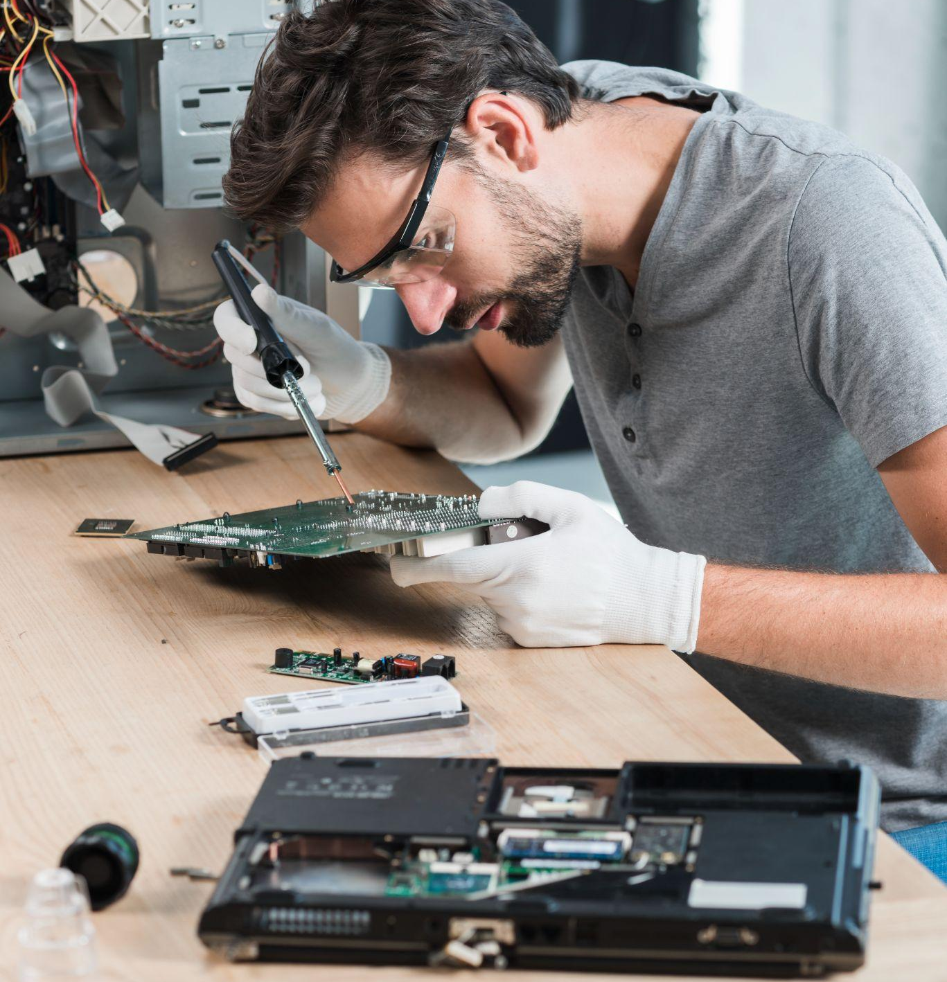
AN IMAGE REINFORCES THE CONCEPT
Images reveal large amounts of data, so remember: use an image instead of a long text. Your audience will appreciate it

Slide 25


A PICTURE IS WORTH A THOUSAND WORDS

Slide 26
OUR NUMBERS
50%
30%
20%
MANPOWER
DEVELOPMENT
EXPANSION
Mercury is the closest planet to the Sun and the smallest of them all
Venus has a beautiful name and is the second planet from the Sun
Despite being red, Mars is actually a cold place. It’s full of iron oxide dust

Slide 27
PROJECT GOALS
GOAL 1
Mercury is the closest planet to the Sun
GOAL 2
Venus is the second planet from the Sun
GOAL 3
Earth is the third planet from the Sun

Slide 28
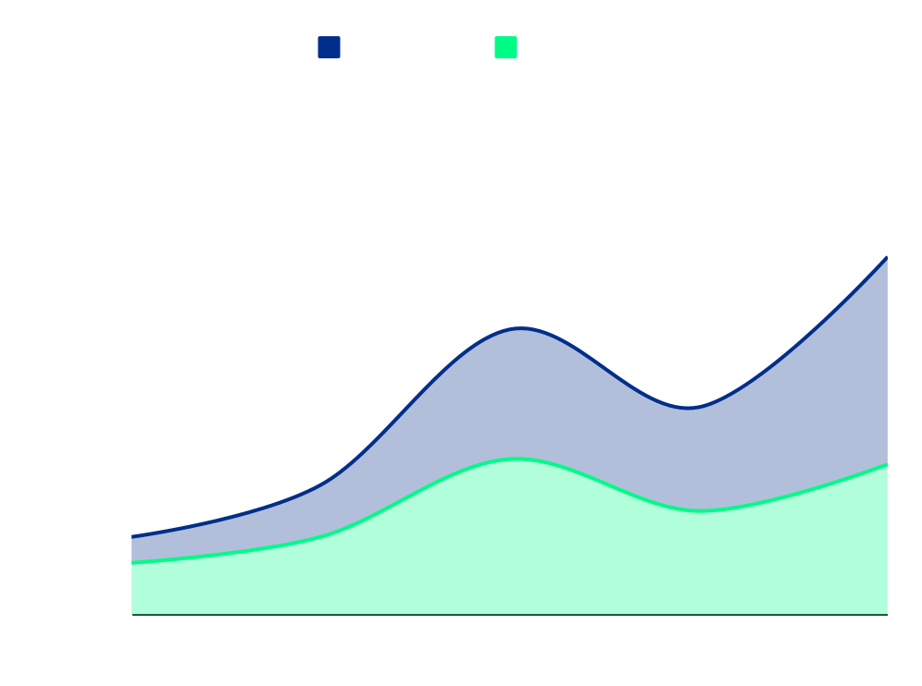
PREDICTED RESULTS
300
$30,000
New employees next year
Expected income for 20XX
Follow the link in the graph to modify its data and then paste the new one here. For more info, click here

Slide 29
AI IN A NUTSHELL
Do you know what helps you make your point crystal clear?
Lists like this one:
They’re simple
You can organize your ideas clearly
You’ll never forget to buy milk!
And the most important thing: the audience won’t miss the point of your presentation

Slide 30
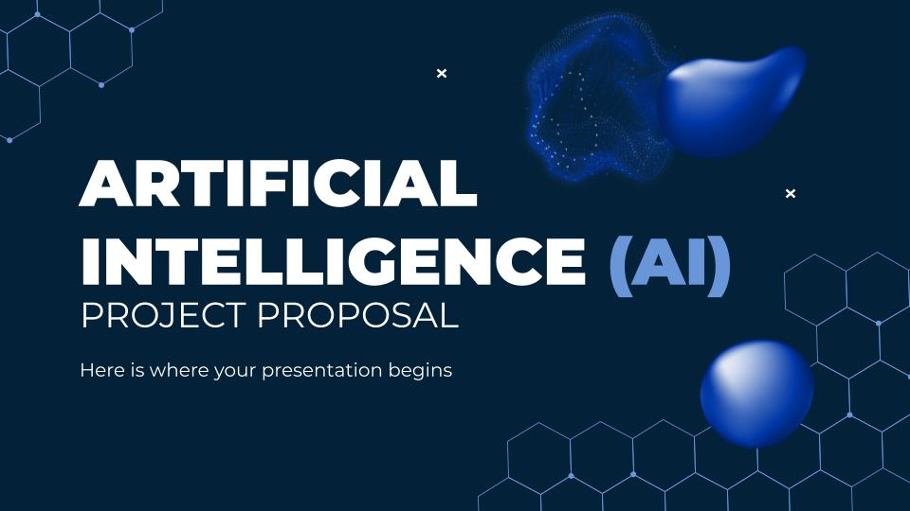
DESKTOP MOCKUP
You can replace the image on the screen with your own work. Just right-click on it and select “Replace image”

Slide 31
SNEAK PEEK
Mercury is the closest planet to the Sun and the smallest one in the Solar System—it’s only a bit larger than the Moon. The planet’s name has nothing to do with the liquid metal, since Mercury was named after the Roman messenger god

Slide 32

SNEAK PEEK
You can replace the image. Just right-click on it and select “Replace image”

Slide 33
TYPES OF AIs
NAME | TYPE | FUNCTION
My Journey | Artistic | Creates images
Super Desk | Writer | Creates texts
Solver | Mathematician | Solves complex problems
Develop AI | Programer | Programs web pages

Slide 34
PROJECT STAGES
Venus is the second planet from the Sun
STAGE 1
Despite being red, Mars is very cold
STAGE 2
Jupiter was named after a Roman god
STAGE 3

Slide 35
TIMELINE
Earth is the planet with life
Saturn is a
ringed planet
DAY 2
DAY 4
DAY 1
DAY 3
Despite being red, Mars is a cold place
Jupiter doesn’t have a solid surface

Slide 36
OUR PARTNERS
JOHNSON
TECH PEK
DOE’S
The Moon is Earth’s only natural satellite
Earth is the planet where we all live
Mars was named after a god
PETPER
ENGEEN
MERIDIAN
Jupiter doesn’t have a solid surface
Saturn was named after a Roman god
Neptune is far away from us

Slide 37
OUR LOCATION
SILICON VALLEY, SF
Despite being red, Mars is actually a cold place. It's full of iron oxide dust, which gives the planet its reddish cast

Slide 38


OUR TEAM
TIMMY JIMMY
You can speak a bit about this person here
DANA JONES
You can speak a bit about this person here

Slide 39
THANKS!
DO YOU HAVE ANY QUESTIONS?
youremail@freepik.com
+34 654 321 432
yourwebsite.com
Please keep this slide for attribution

Slide 40
ICON PACK

Slide 41
ALTERNATIVE RESOURCES
Here’s an assortment of alternative resources whose style fits the one of this creative template:
VECTORS
Gradient metaverse concept twitch banner

Slide 42
RESOURCES
Did you like the resources on this template? Get them for free at our other websites:
VECTORS
Futuristic ai tech instagram posts collection
ICONS
Icon pack: Artificial intelligence
PHOTOS
Black man working with a computer
Male technician repairing computer motherboard on wooden desk
Close up smiley man with glasses
Front view smiley woman holding book
Hands typing on laptop keyboard

Slide 43
Instructions for use
If you have a free account, in order to use this template, you must credit Slidesgo by keeping the Thanks slide. Please refer to the next slide to read the instructions for premium users.
As a Free user, you are allowed to:
Modify this template.
Use it for both personal and commercial projects.
You are not allowed to:
Sublicense, sell or rent any of Slidesgo Content (or a modified version of Slidesgo Content).
Distribute Slidesgo Content unless it has been expressly authorized by Slidesgo.
Include Slidesgo Content in an online or offline database or file.
Offer Slidesgo templates (or modified versions of Slidesgo templates) for download.
Acquire the copyright of Slidesgo Content.
For more information about editing slides, please read our FAQs or visit our blog:
https://slidesgo.com/faqs and https://slidesgo.com/slidesgo-school

Slide 44
Instructions for use (premium users)
As a Premium user, you can use this template without attributing Slidesgo or keeping the "Thanks" slide.
You are allowed to:
Modify this template.
Use it for both personal and commercial purposes.
Hide or delete the “Thanks” slide and the mention to Slidesgo in the credits.
Share this template in an editable format with people who are not part of your team.
You are not allowed to:
Sublicense, sell or rent this Slidesgo Template (or a modified version of this Slidesgo Template).
Distribute this Slidesgo Template (or a modified version of this Slidesgo Template) or include it in a database or in any other product or service that offers downloadable images, icons or presentations that may be subject to distribution or resale.
Use any of the elements that are part of this Slidesgo Template in an isolated and separated way from this Template.
Register any of the elements that are part of this template as a trademark or logo, or register it as a work in an intellectual property registry or similar.
For more information about editing slides, please read our FAQs or visit our blog:
https://slidesgo.com/faqs and https://slidesgo.com/slidesgo-school

Slide 45
Fonts & colors used
This presentation has been made using the following fonts:
Montserrat
(https://fonts.google.com/specimen/Montserrat)
#ffffff
#032138
#6995d9
#002e8a
#00fb87
#00ccac

Slide 46





Storyset
Create your Story with our illustrated concepts. Choose the style you like the most, edit its colors, pick the background and layers you want to show and bring them to life with the animator panel! It will boost your presentation. Check out how it works.
Pana
Amico
Bro
Rafiki
Cuate

Slide 47
Use our editable graphic resources...
You can easily resize these resources without losing quality. To change the color, just ungroup the resource and click on the object you want to change. Then, click on the paint bucket and select the color you want. Group the resource again when you’re done. You can also look for more infographics on Slidesgo.

Slide 50
JANUARY
FEBRUARY
MARCH
APRIL
MAY
JUNE
PHASE 1
Task 1
Task 2
PHASE 2
Task 1
Task 2
JANUARY
FEBRUARY
MARCH
APRIL
PHASE 1
Task 1
Task 2

Slide 53
...and our sets of editable icons
You can resize these icons without losing quality.
You can change the stroke and fill color; just select the icon and click on the paint bucket/pen.
In Google Slides, you can also use Flaticon’s extension, allowing you to customize and add even more icons.

Slide 54
Educational Icons
Medical Icons

Slide 55
Business Icons
Teamwork Icons

Slide 56
Help & Support Icons
Avatar Icons

Slide 57
Creative Process Icons
Performing Arts Icons

Slide 58
Nature Icons

Slide 59
SEO & Marketing Icons

Slide 60


